Slide 1




CASE STUDY 1
Presented by:
SABAREESH POTNURU
Kundan MOURYA
GANEDI SATYA HARIKA
BHUPATHI VARUN
1

Slide 2


ABOUT CASE
OBJECTIVE
Explore the challenges of predicting daily surgical case volumes at Vanderbilt University Medical Center (VUMC)
How advanced business analytics can be applied to improve surgical scheduling and resource allocation.
2

Slide 3
THE MAIN ISSUE:
UNPREDICTABLE DAILY SURGERIES
What’s the problem?
The hospital plans surgeries weeks ahead, but the exact number of surgeries each day isn’t confirmed until the day before. This makes it hard to schedule staff and resources properly.
Daily surgeries average 116 but can swing wildly (e.g., 30+ more or fewer than expected).
6% of surgeries are last-minute emergencies, adding to the chaos.
Why is this a big deal?
Overstaffing wastes money.
Understaffing leads to delays, overtime costs, or even canceled surgeries.
Departments like nursing, anesthesia, and equipment suppliers need accurate daily forecasts to prepare.
3

Slide 4
WHY DOES THE NUMBER OF SURGERIES VARY SO MUCH?
Surgeons’ habits:
Many avoid scheduling surgeries on Fridays or block off weeks for vacations/conferences.
Some entire departments (e.g., heart surgery) might take a week off, creating slow days followed by busy ones.
Emergencies:
Last-minute “add-on” surgeries (6% of total) disrupt the schedule.
Monthly vs. daily planning:
The Finance Department predicts monthly totals accurately (within 5% error) but can’t predict daily numbers.
4

Slide 5
HOW THE HOSPITAL TRIES TO MANAGE THIS
Day-before adjustments:
At 5 PM daily, the schedule for the next day is finalized.
If too few surgeries: Close operating rooms, send nurses home.
If too many: Call in extra staff, delay surgeries, or cancel some.
Impact on other departments:
Sterile equipment suppliers start packing surgical tools at 7 PM the night before. High-volume days risk delays if they’re underprepared.
Anesthesiologists may have to cancel research days (10-20% of their work) if surgeries spike.
5

Slide 6
THE DATA THEY HAVE
48 weeks of booking history:
Every day at 4:30 PM, they saved a “snapshot” of upcoming surgeries booked for the next 30 days.
After cleaning duplicates and weekends, they had 241 days of data (7,230 records).
What’s in the data?
How surgeries were booked over time (e.g., a surgery scheduled 3 weeks ahead shows up in 21 daily snapshots).
6

Slide 7
THE GOAL: PREDICT SURGERIES EARLIER
Ajay Bose’s task:
Use the booking data to predict daily surgery counts weeks in advance.
Example: If he can predict "Next Thursday will have 130 surgeries," staff can plan better.
Why it matters:
Save costs (avoid over/understaffing).
Reduce stress on nurses and equipment teams.
Prevent delays or cancellations for patients.
7

Slide 8
CHALLENGES TO SOLVE & BIG PICTURE
Unpredictable factors:
Surgeon preferences, emergencies, and equipment delays.
Turning data into action:
Can historical patterns predict future days? How far in advance?
Will hospitals trust the predictions enough to change staffing?
Hospitals need analytics:
Pressure to cut costs while improving care.
Data (like surgery schedules) can help optimize staff, rooms, and supplies.
Success here could lead to:
Better tools for predicting bed shortages, ER wait times, or equipment needs.
8

Slide 9

INSIGHTS
9

Slide 10
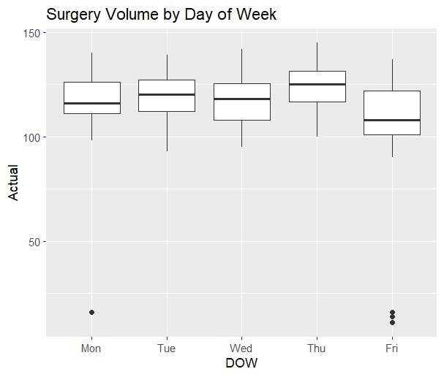
In which day of the week, the surgeries are done most?
10

Slide 11
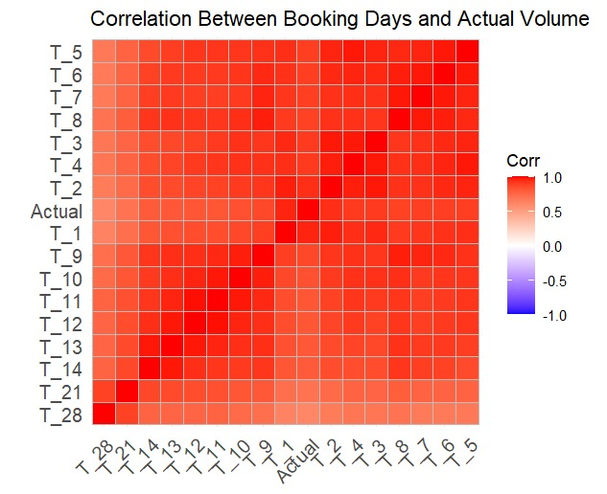
Its a highly correlated case.
11

Slide 12
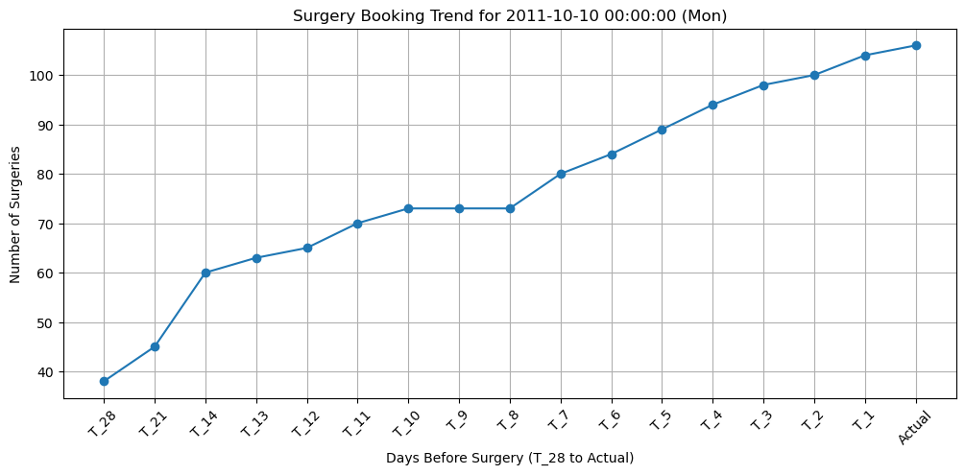
12

Slide 13
The graph suggests a steady increase in bookings as the surgery date approaches, with a sharper rise in the earlier days.
This tells us that where more patients confirm their surgeries closer to the actual date.
13

Slide 14
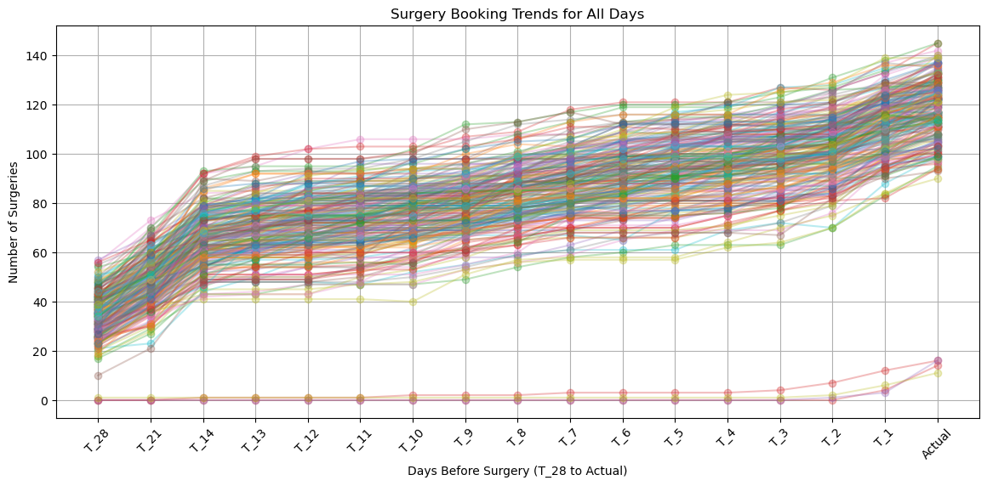
14

Slide 15
Plot Type: Line plot displaying the number of surgeries booked from 28 days before surgery (T_28) to the surgery day (Actual).
Data: Each line represents one surgery day, with points at T_28, T_21, ..., T_1, and Actual.
X-axis: Days before surgery (e.g., 28, 21, ..., 1, Actual).
Y-axis: Number of surgeries booked/performed.
Trend: Lines slope upward as the surgery date nears, showing more bookings closer to the date.
15

Slide 16
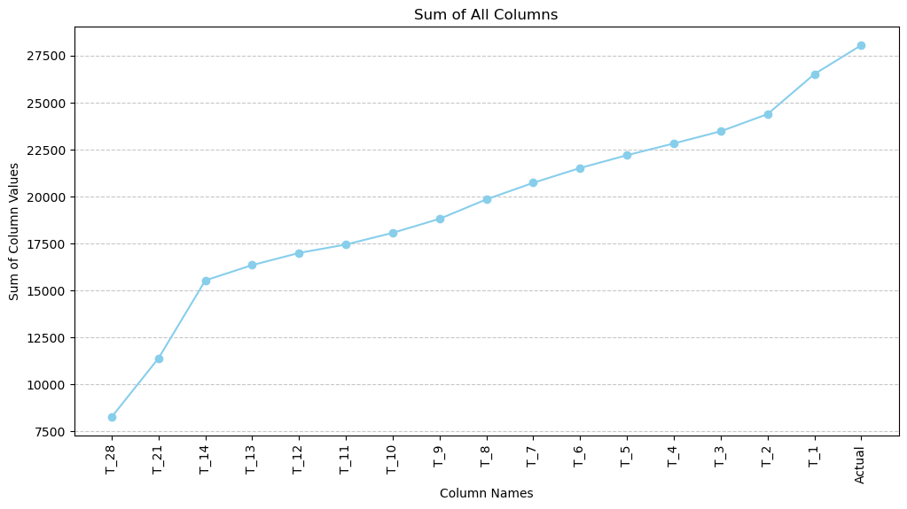
16

Slide 17
Visualization: Creates a line plot with markers to display sums, where:
X-axis: Lists column names (e.g., T_28, T_1, Actual).
Y-axis: Shows the sum of values for each column.
Design: Includes a grid, rotated x-axis labels, and a skyblue line for clarity and readability
Insight: Highlights trends, such as increasing sums as lead time decreases, reflecting booking or activity patterns.
Significance: Provides a quick snapshot of data scale and distribution, useful for trend analysis or resource planning.
17

Slide 18
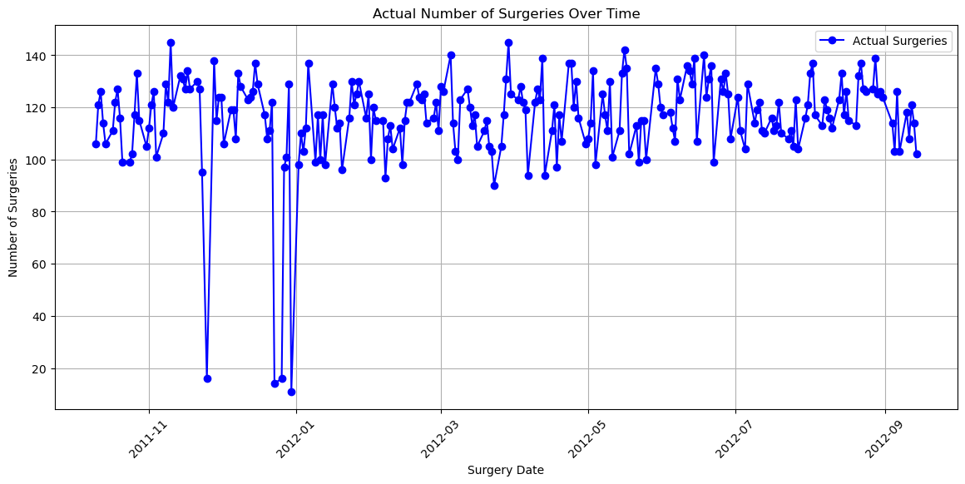
18

Slide 19
Insight: This visualization can reveal patterns such as weekly cycles, seasonal variations, or unexpected changes in surgery numbers.
Significance: By showing how surgery volumes fluctuate over time, it supports better resource planning, scheduling, and demand management in a healthcare setting.
19

Slide 20
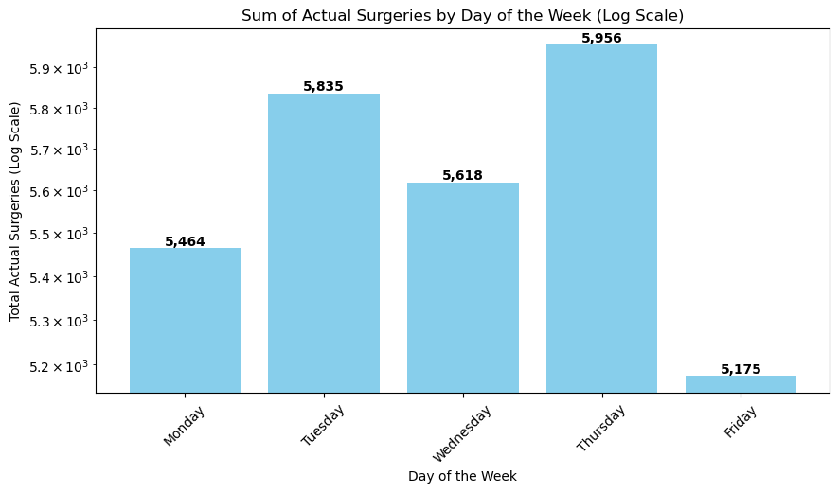
Data: Groups data by DOW (Day of the Week), sums Actual surgeries, and reorders days from Monday to Sunday.
Visualization:
Labels: X-axis as "Day of the Week," Y-axis as "Total Actual Surgeries (Log Scale)," and title "Sum of Actual Surgeries by Day of the Week (Log Scale)."
Insight: Highlights weekly surgery patterns, aiding resource planning by revealing high and low volume days effectively through the log scale.
20

Slide 21
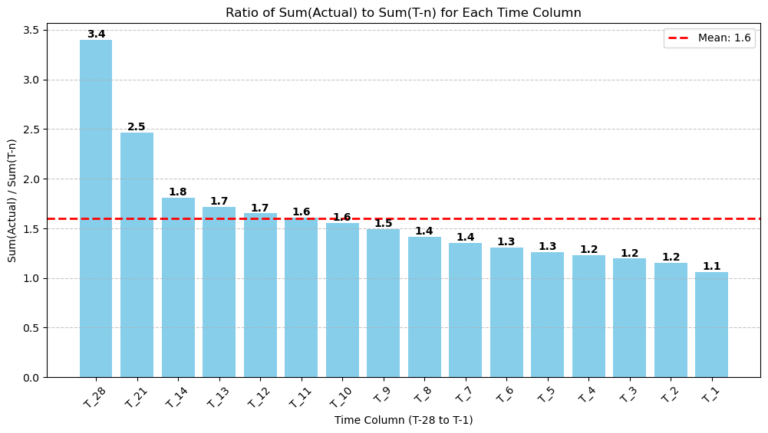
Insight
The plot reveals how booking completeness changes over time:
Ratio ≈ 1: Bookings at that time point are nearly complete.
Ratio > 1: Many surgeries are added later, indicating incomplete early bookings.
Mean Ratio: Serves as a benchmark for overall booking trends.
This visualization aids in understanding booking dynamics for better scheduling and resource planning.
21

Slide 22
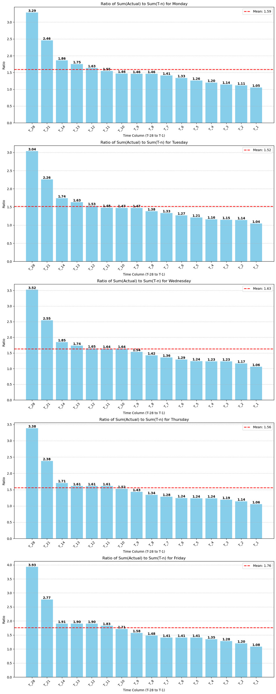
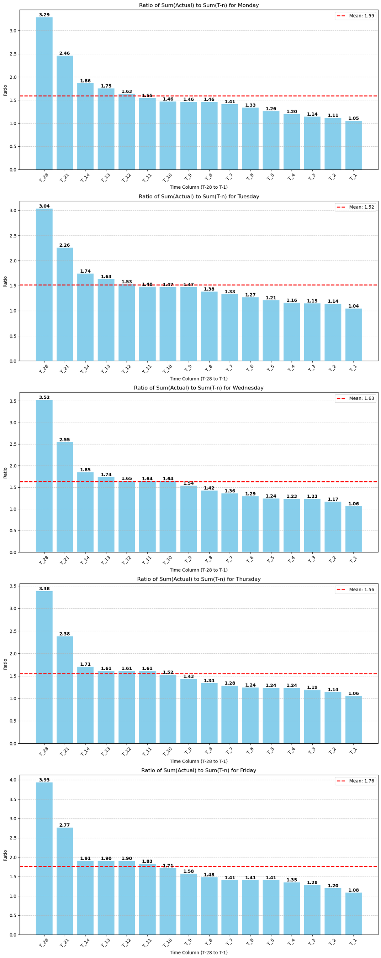
The visualization reveals day-specific booking patterns:
Variability: Ratios differ across days, suggesting unique trends (e.g., Mondays might show more last-minute bookings with lower early ratios).
Trend Analysis: The mean ratio per day helps identify days where early bookings are less predictive of actual surgeries.
Practical Use: This can guide scheduling and resource allocation by highlighting when and where adjustments are needed.
22

Slide 23
23

Slide 24
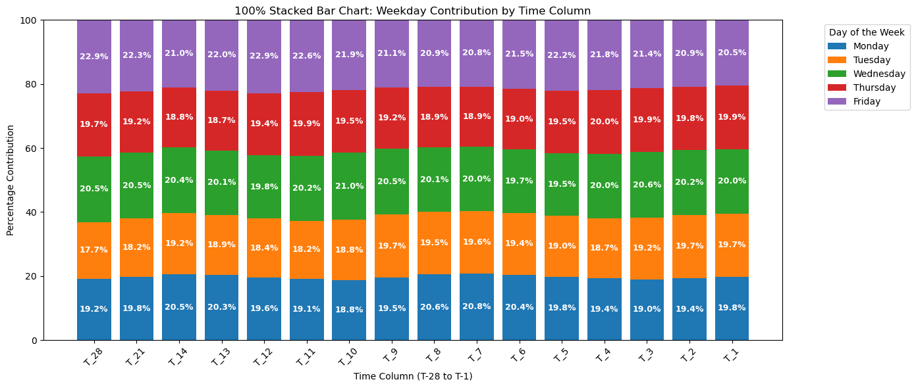
This stacked bar chart visualizes each weekday’s percentage contribution to surgery bookings across time columns (from T-28 to T-1).
For each time column, the actual surgery totals are divided by the column sum, then normalized to 100%.
Each bar segment represents a weekday's contribution, with labels on segments above 5%. This reveals the temporal distribution of booking activity by weekday, aiding schedule optimization.
24

Slide 25
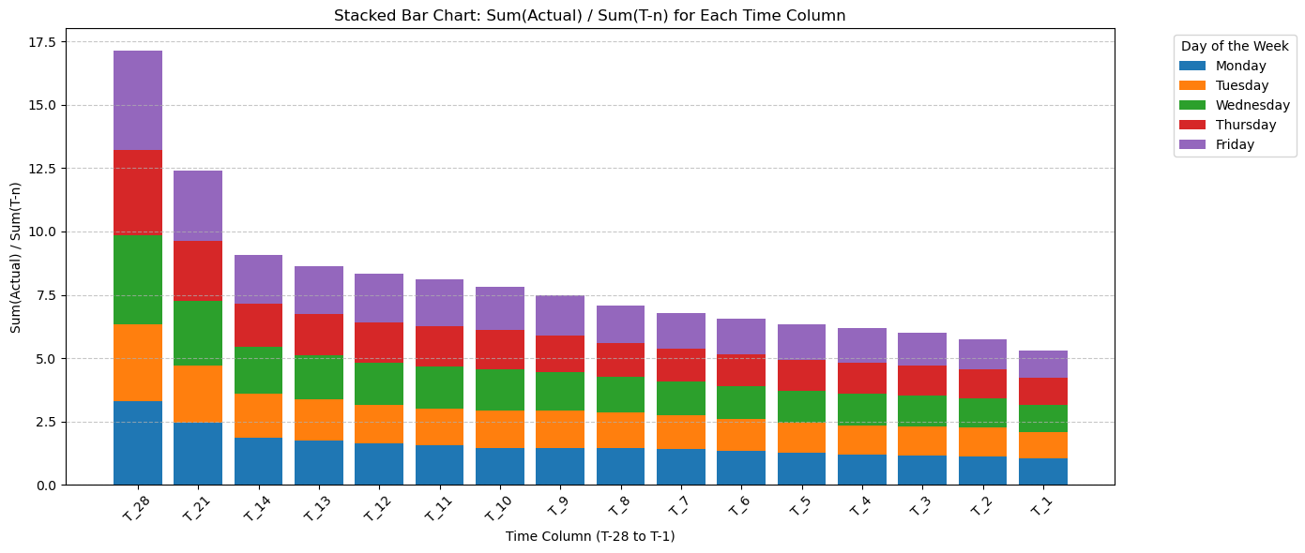
25

Slide 26
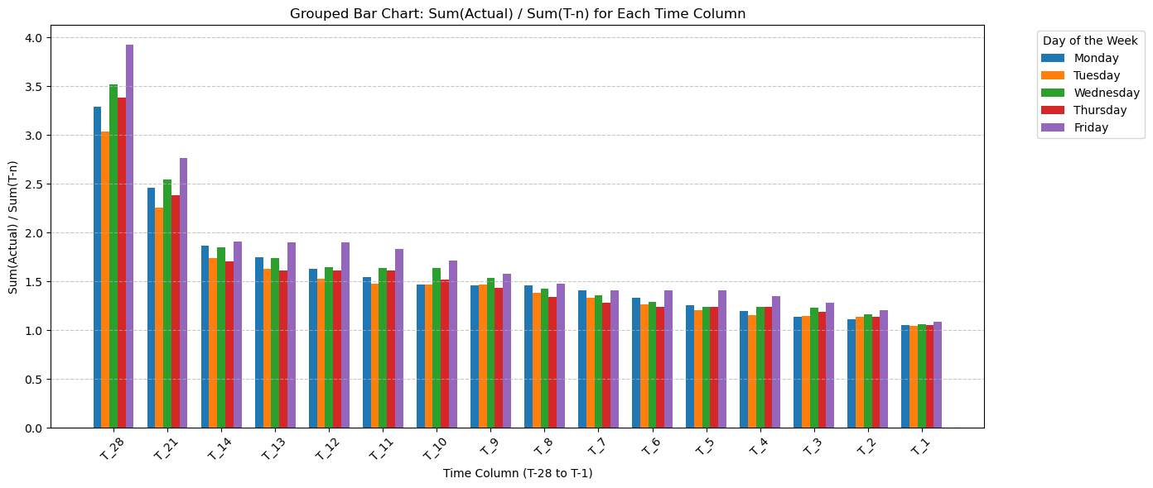
This grouped bar chart compares the ratio of actual surgeries to bookings (T-n) for each weekday across the timeline from T-28 to T-1. Each group represents a time column, with individual bars showing the weekday-specific contributions. This visualization helps pinpoint which weekdays have higher conversion rates from bookings to completed surgeries, offering insight into scheduling trends.
26

Slide 27
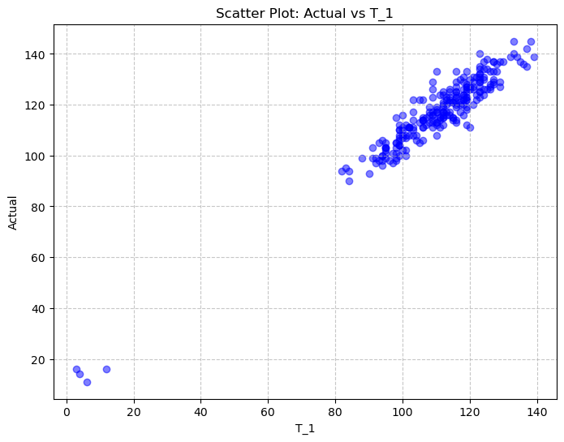
27

Slide 28
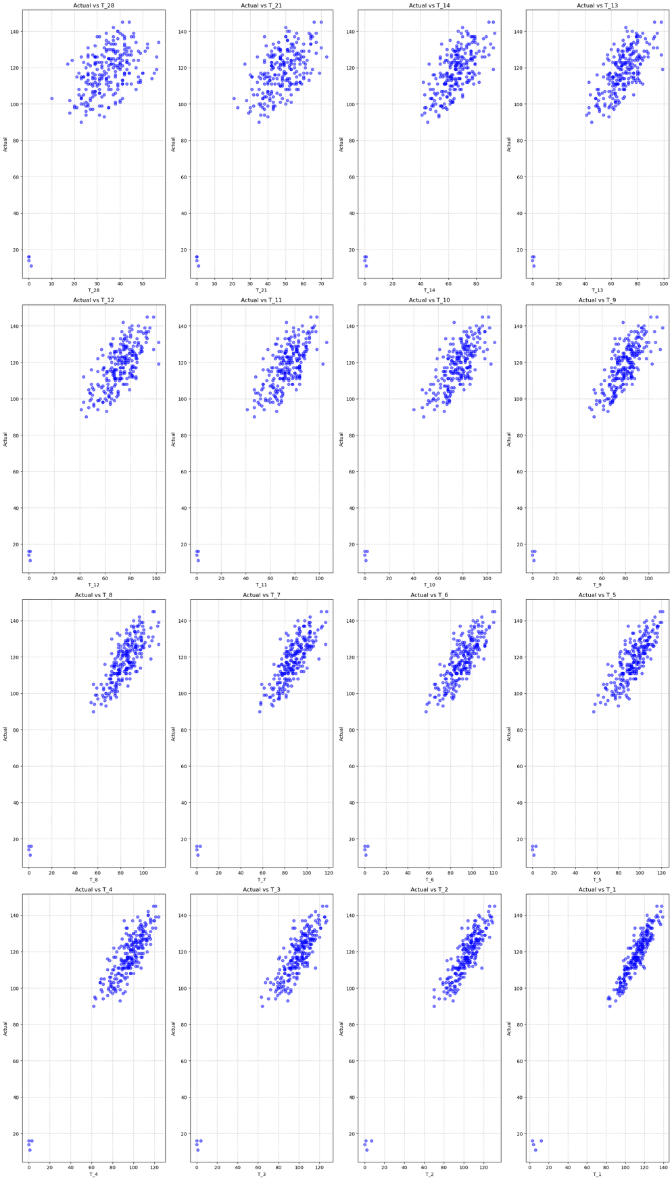
28

Slide 29

PREDICTIVE MODELS
29

Slide 30

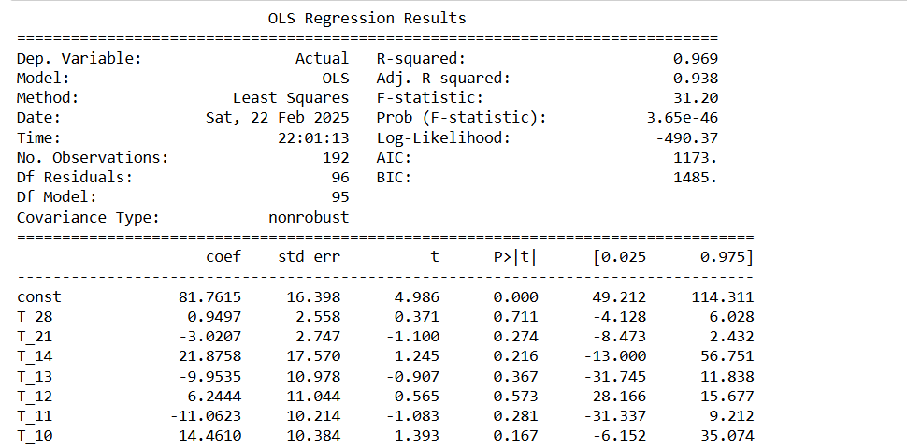
MODEL 1
Considering all the features
30

Slide 31
The model has a high R-squared (0.969), indicating a strong fit.
Adjusted R-squared (0.938) confirms the model explains most variance.
F-statistic (31.20, p = 3.56e-46) suggests overall significance.
Most predictors have high p-values (>0.05), meaning they are not individually significant.
Intercept (81.7615, p < 0.001) suggests a strong baseline effect.
Further refinement is needed to improve individual predictor significance.
31

Slide 32
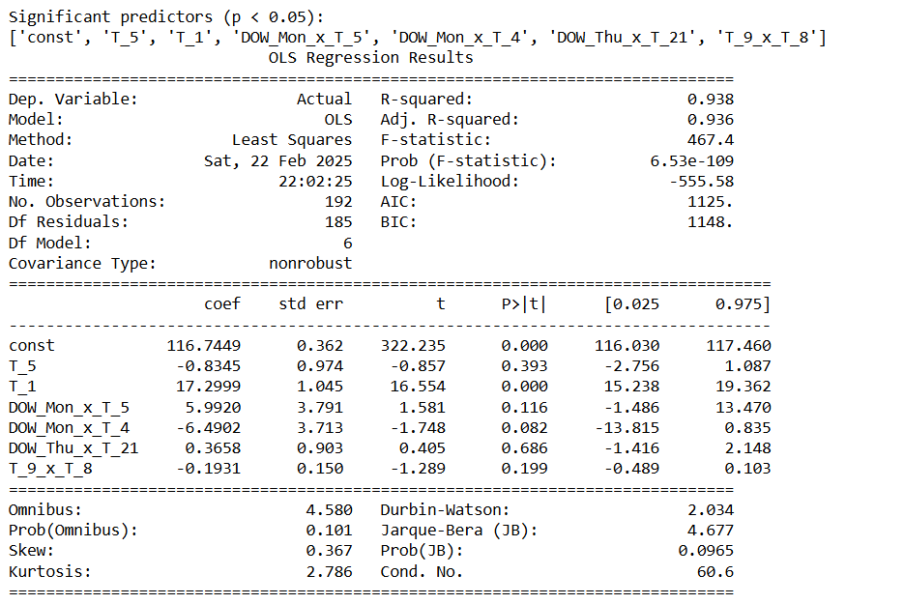
MODEL 2
Considering significant features
32

Slide 33
The model has a high R-squared (0.938), indicating a strong fit.
Adjusted R-squared (0.936) confirms good explanatory power.
F-statistic (467.4, p ≈ 0.00) shows overall significance.
Some predictors have low p-values (<0.05), meaning they are statistically significant.
Intercept (116.7449, p < 0.001) suggests a strong baseline effect.
The model includes interaction terms, indicating possible combined effects of variables.
Durbin-Watson (2.034) suggests no strong autocorrelation in residuals.
33

Slide 34
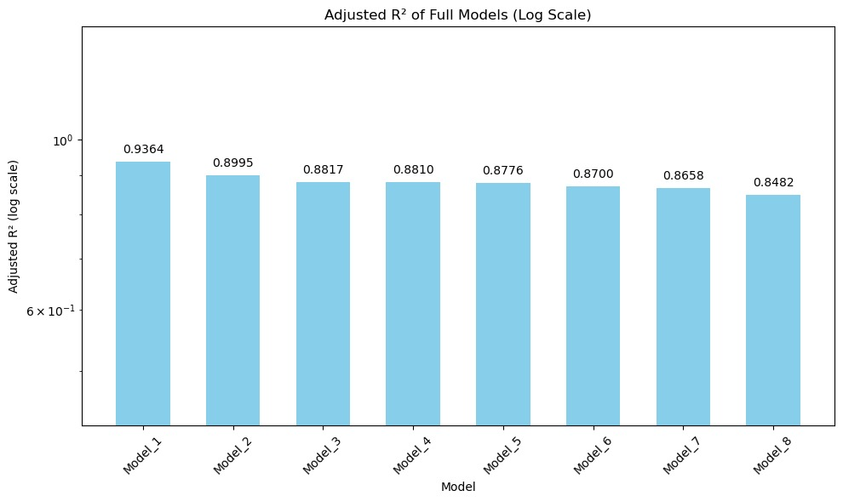
MODELS
Dropping the T_n columns
The code preprocesses a surgical booking dataset by selecting features, one-hot encoding the day-of-week, and standardizing time variables. It creates interaction terms between dummy variables and time columns as well as between adjacent time columns.
Several OLS regression models are then fitted by sequentially dropping recent booking columns (T_1, T_2, etc.) to assess the impact on model performance.
Finally, the adjusted R² values are plotted on a logarithmic scale to compare predictive accuracy across model variations.
34

Slide 35

THANK YOU
35

